Slide 1







Slide 2
Facebook Integration In Educare

Slide 3

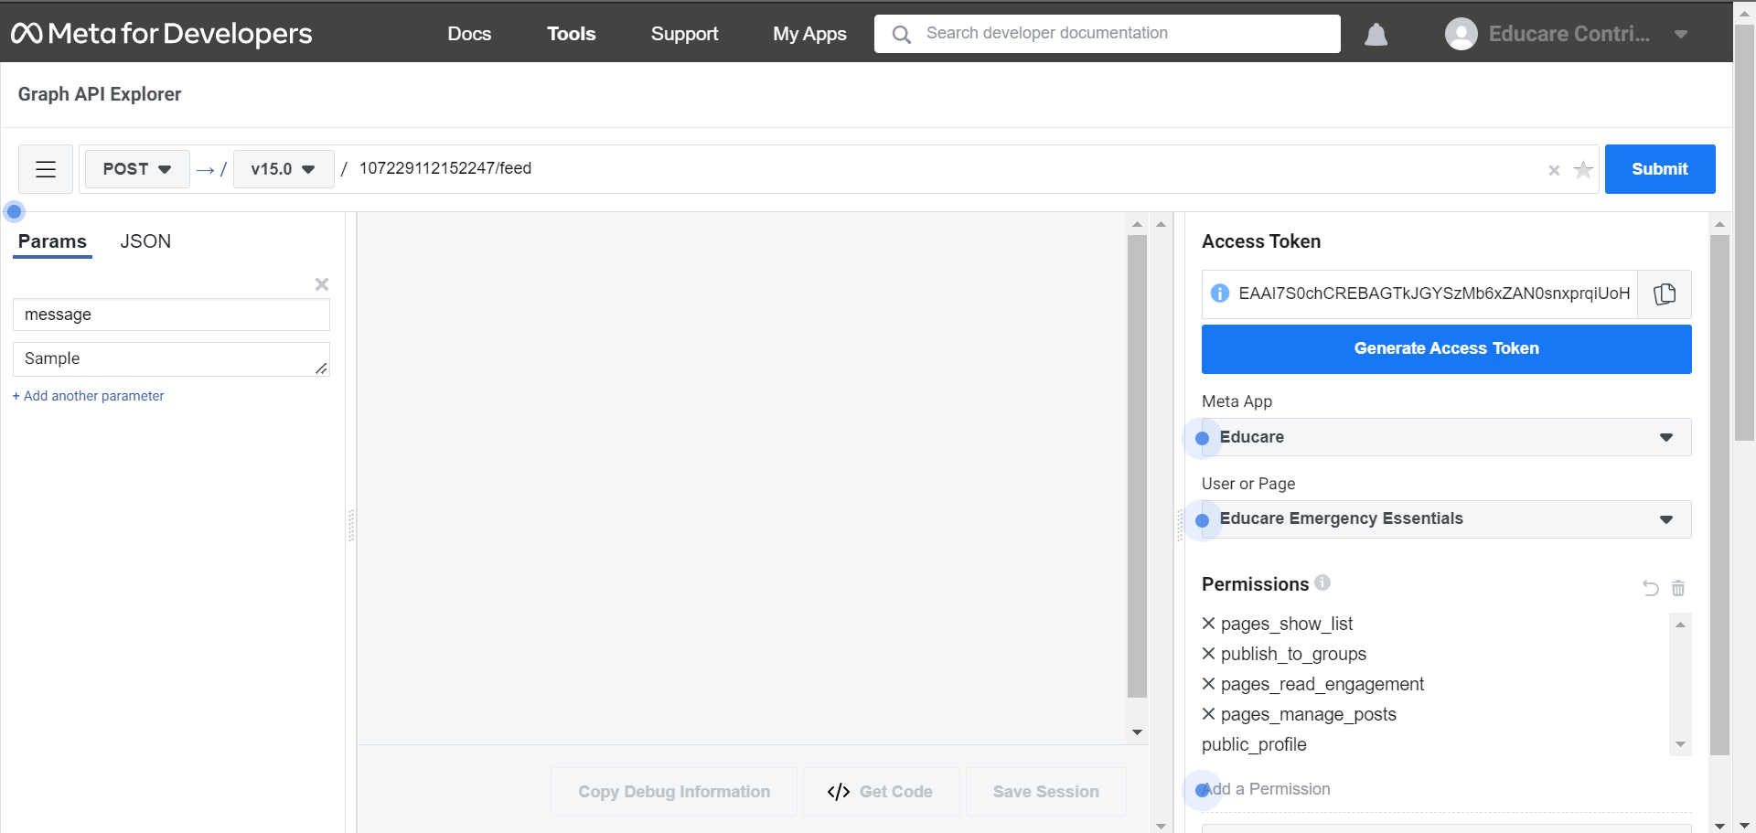
Facebook integration in Educare​
So, whenever if any emergency essential is raised it requires approval of respective district officer.
So, once it is approved then we are posting it in educare facebook page.
Essentials Case
Educational Institution
If Emergency Essential ?
Initially we have created a facebook page. https://www.facebook.com/EducareEmergencyEssentials
So it is used for posting the emergency essential in facebook page.
Face Book Graph API is used for generating the Access Token in order to post it in the facebook page.
After testing it in Facebook Graph API ,We have to do integration in educare.

Slide 4
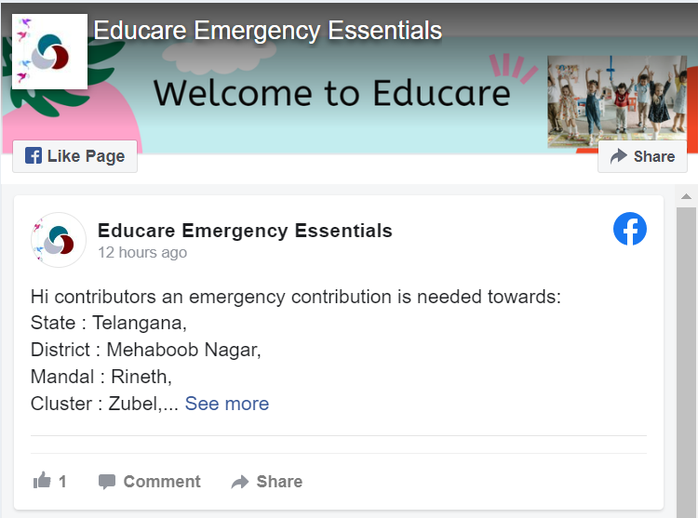
Facebook integration in Educare
We have used the Connect-Rest & Post Method in Pega
Authenticated using access token .
And posted the message through post in facebook page
Connect-Rest
Resource Path:
https://graph.facebook.com/v15.0/107229112152247/feed
Parameters :
Message: Example
Hi contributors an emergency contribution is needed towards:
State : Telangana,
District : Mehaboob Nagar,
Mandal : Rineth,
Cluster : Zubel,
School : Balak Mata Centre (Matia Mahal), 26, Matia Mahal
We hope that all contributors can look towards these emergency essential, You can contribute through our website link below mentioned
https://ljatdbh4.pegace.net/prweb/PRAuth/Educare-guest
Access-Token:EAAI7S0chCREBAC************************yvdsINPnrhxsPi2K500KWEQUR1KEZAKoZAZB9bvKqby4m0igd3TtYmp07Xr0ZD

Slide 5
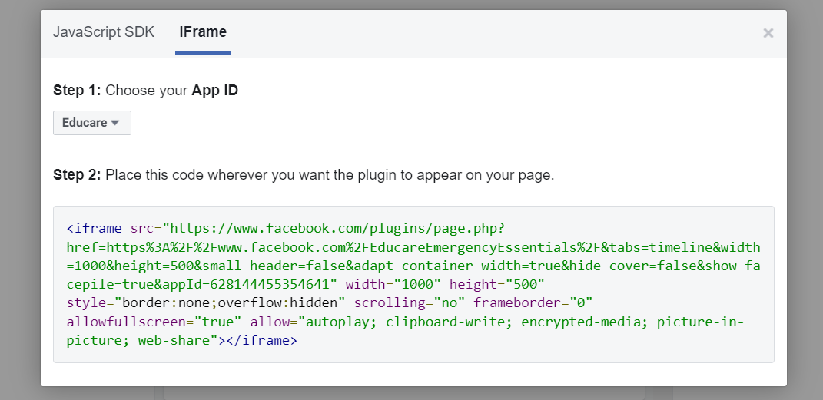
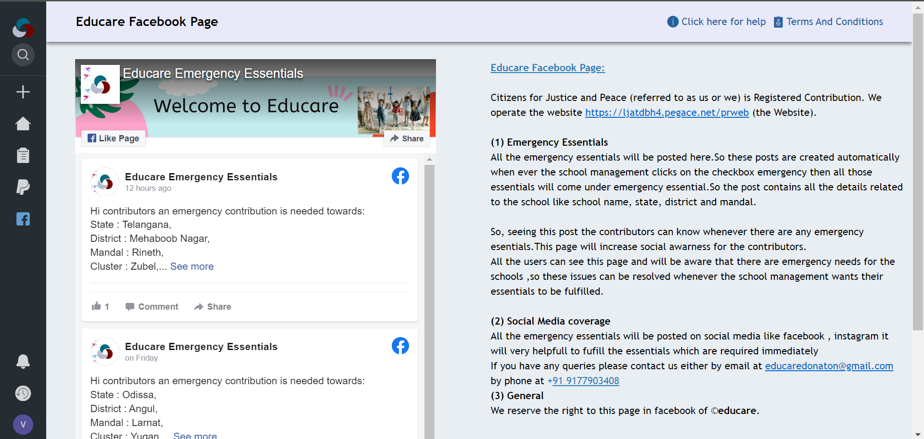
Facebook Page plugin in Educare
1.We have embed the facebook page plugin in pega, so it will be used to promote the educare website and to get the better social media reach through the globe.
It can be used to see the emergency essentials and can be used to share the posts.
Facebook provides the Plugin code so we have used it in our educare website.
We have used iframe code in section

Slide 6
Google SSO In Educare

Slide 7

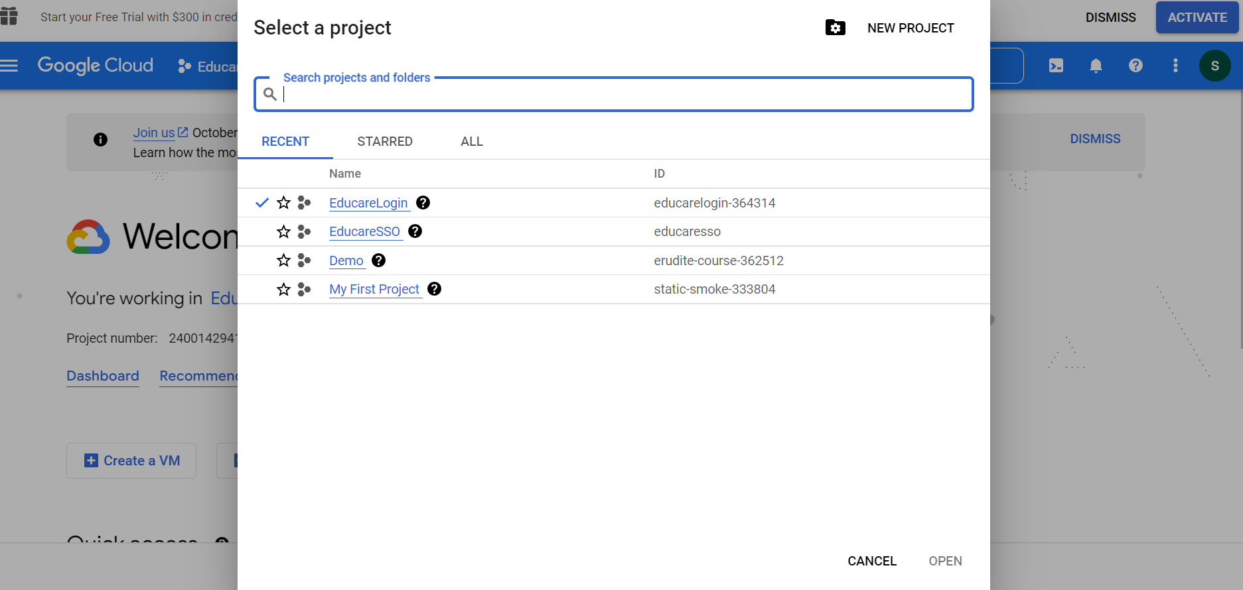
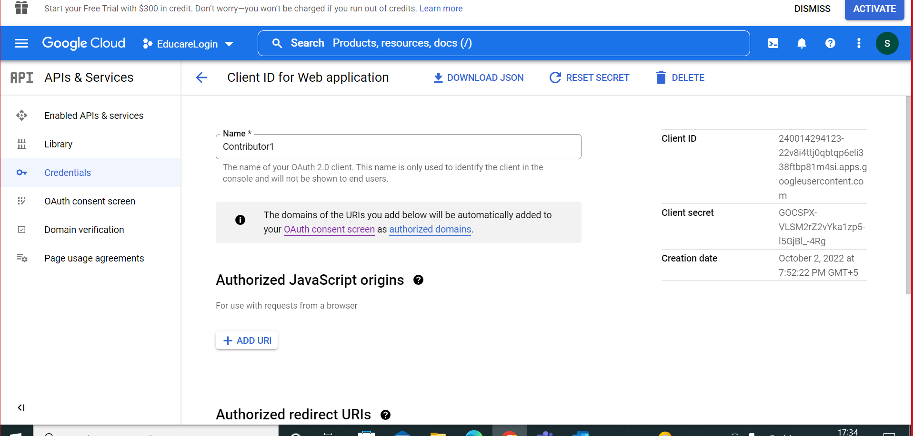
Creating credentials in Google API Console
Initially we have to create a project in the Google API console
Mention the developers and the organization
Then create credentials and the URL that is generated by pega should be attached to it
Client Id and client secret will be generated for reference.

Slide 8
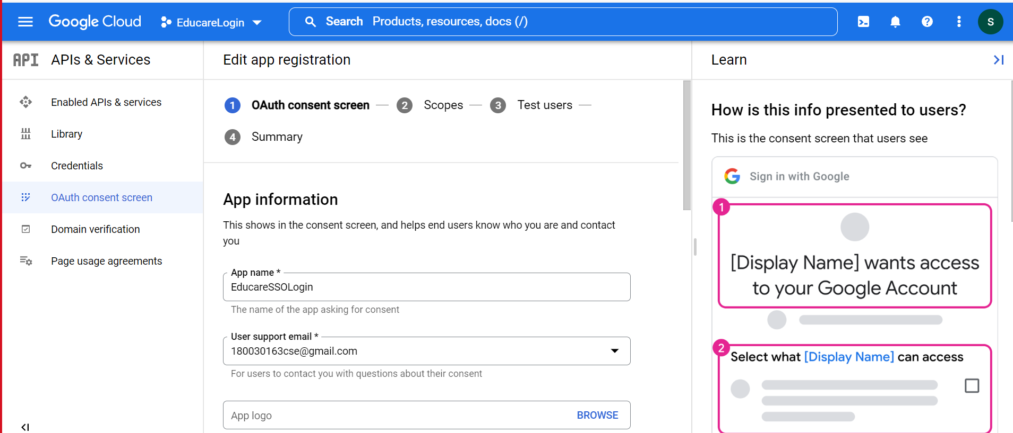
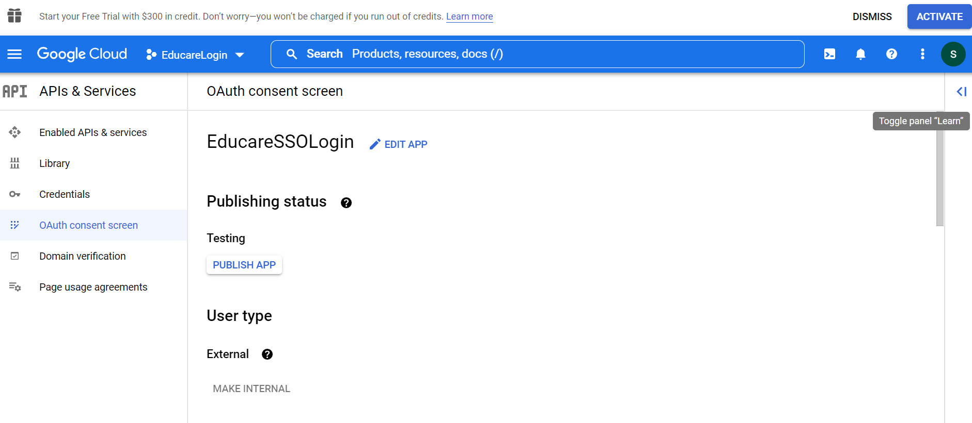
Creating OAuth consent screen in Google API Console
After creating credentials were created.
Create OAuth consent screen where we have to specify all the things regarding our application.
After the consent screen is created publish the respective app.

Slide 9
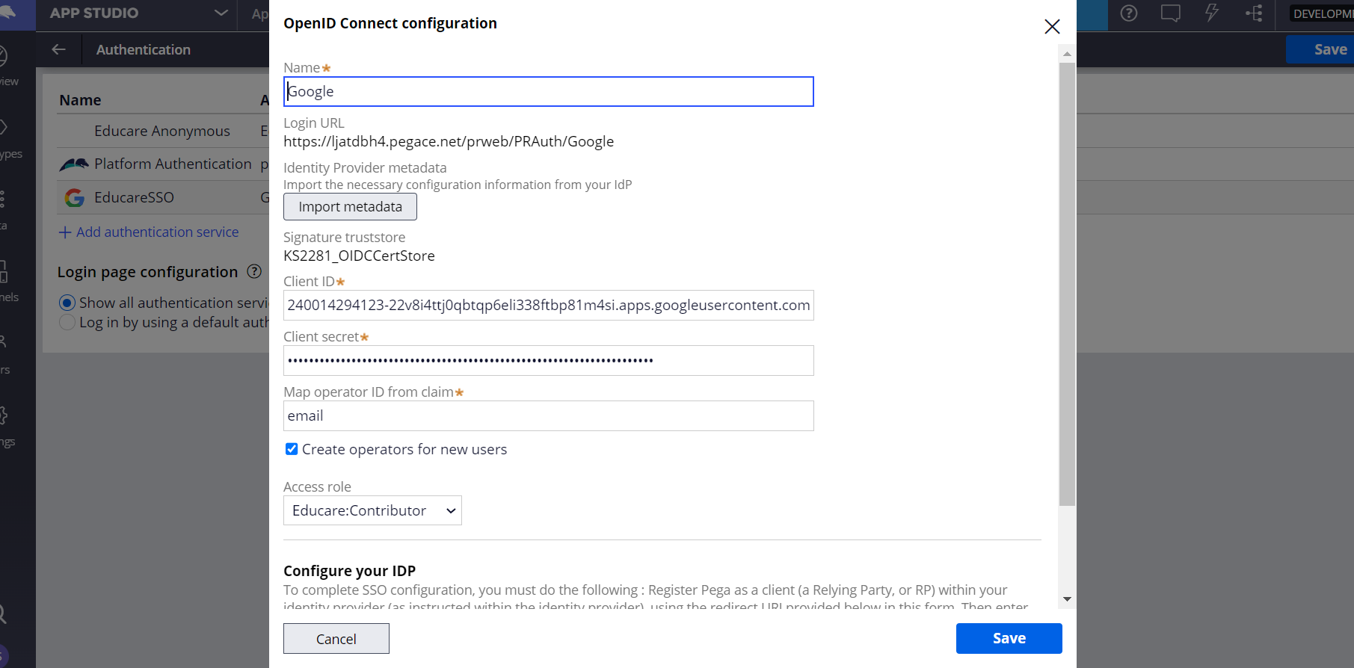
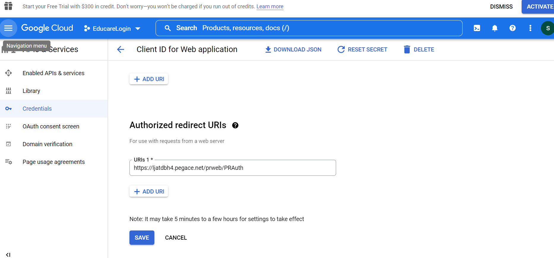
Integrating Google API Console with Educare
Go to app studio there go to user and then authentication
In the authentication create a new one for google
Then given the client ID and client secrete.
Name the sso and the link generated should be added to the credentials

Slide 10
Razor pay integration in Pega

Slide 11

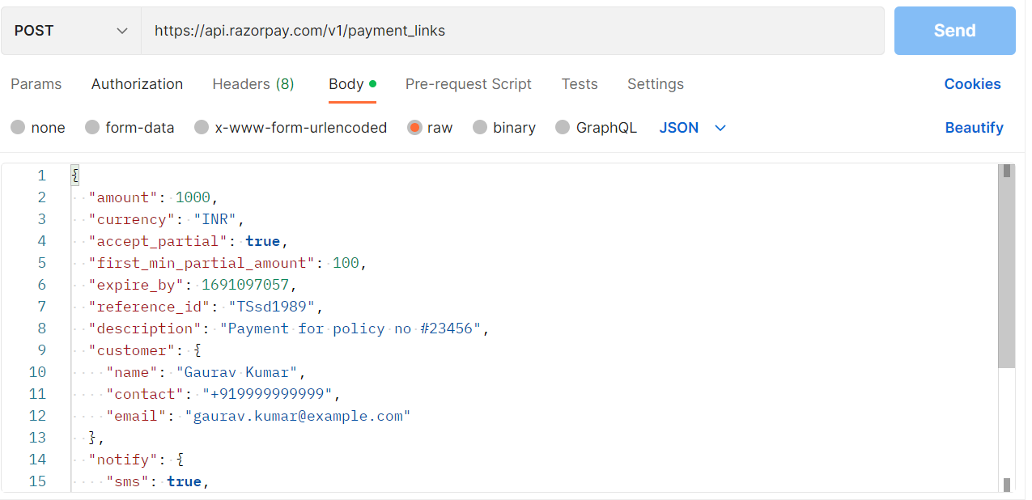
Razor-Pay Payment gateway Integration
We are using Razor-Pay for creating the payment link for the specific transaction so it will have specific id to track that payment from the educare.
We are using Post Method for sending the contributor data to Razor-Pay and Creating the link.
We have tested it in Postman and integrated in Educare application
https://api.razorpay.com/v1/payment_links
Post/payment_links
Connect-Rest Post Method
Basic Auth
JSON Request
<- Payment Link Creation Response to Pega
Based on educational institution the link will generated from there account and while paying it will deposit to there account it will fully controlled by the educational institution

Slide 12
Verifying Payment in Razor-Pay
All the payments which have been done through the Razor-Pay will be stored in educare application with payment id for tracking the payment status.
We will pass the payment Id as a parameter and we will fetch the Payment Status from the Razor-Pay.
https://api.razorpay.com/v1/payments/{pay_id}
GET/payments/:id
<- Sends the Status of Payment
Connect-GET
Basic Auth
Parameter: Search for Payment Id status ->
Based on educational institution the payments will be fetched and searched from their account payments and we will get the status of the payment.

Slide 13
Anonymous Authentication in Pega

Slide 14
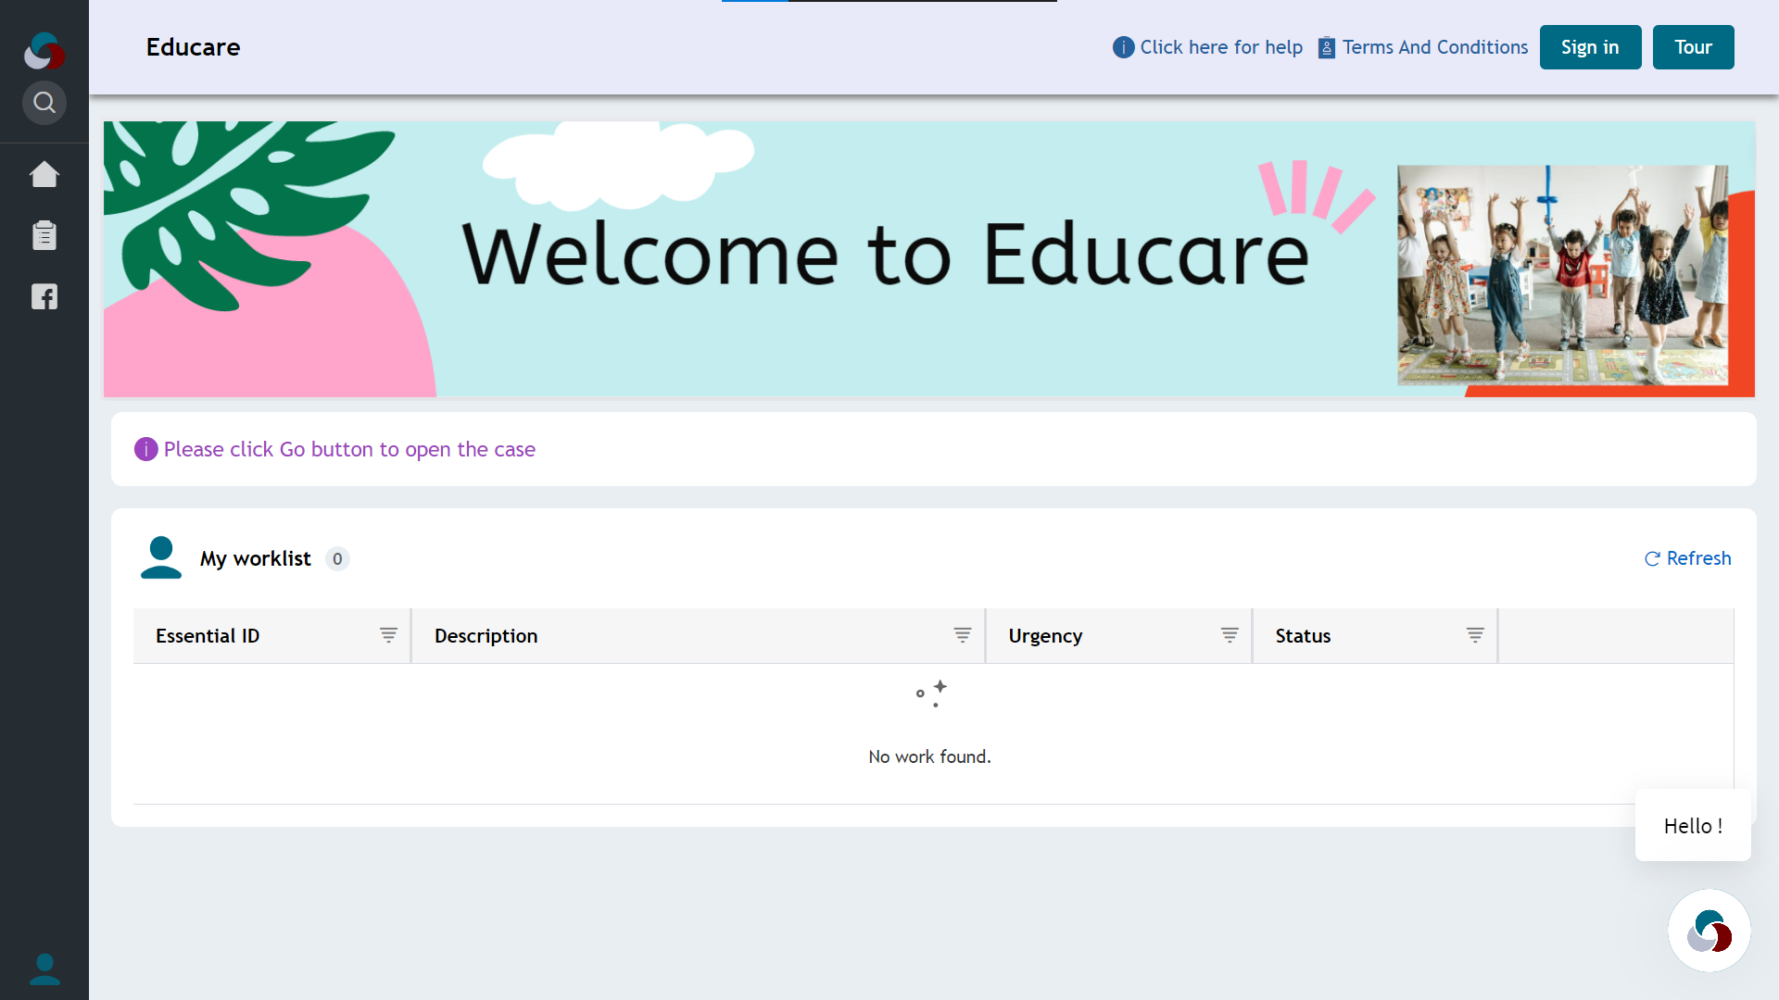
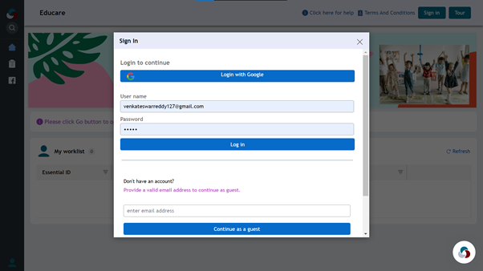
Anonymous Authentication in Educare
Anonymous Authentication is used for the contributors to see the essentials without logging in to the application.

Slide 15

Class Structure of data class
@Baseclass
Data-
NEC-Data-
NEC-Data-District Matrix
NEC-Data-Endowment
NEC-Data-Essential
NEC-Data-Filters
NEC-Data-Mandal Matrix
NEC-Data-Payment
NEC-Data-Provision
NEC-Data-Provision Proof

Slide 16
Thank You

